Slide 1
Design an interactive dashboard for business stakeholders
Tools: Power BI

Slide 2
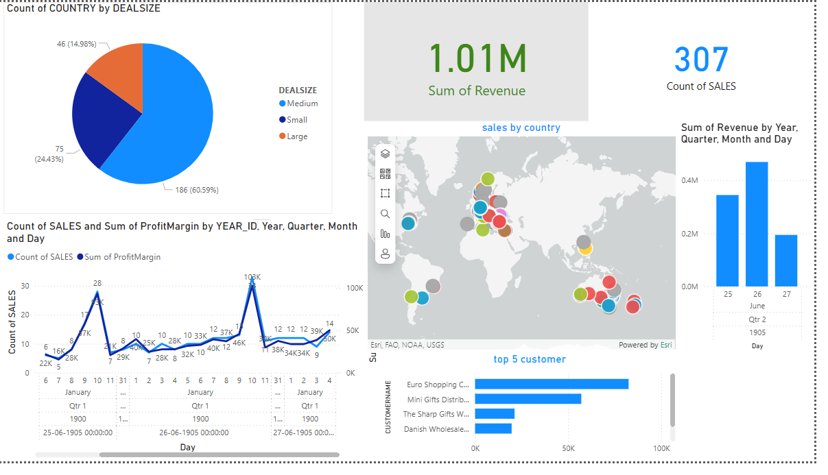

Slide 3

Revenue & Sales Performance Summary
Total Revenue: ₹1.01M
Sales Volume: 307 transactions
Profit Margin Trends: Summarized by year,
quarter, month, and day

Slide 4
Sales Breakdown by Deal Size
Large Deals: 186 (60.59%)
Medium Deals: 46 (14.98%)
Small Deals: 75 (24.43%)

Slide 5
Top 5 Customers (Based on Revenue)
Euro Shopping,
Mini Gifts Distributors,
The Sharp Gifts,
Danish Wholesale
Dragon Souveniers,ltd

Slide 6
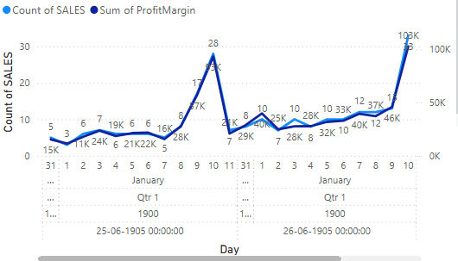
Trends over Time

Slide 7
THANK YOU

